Slide 1
Introduction to DBMS
Day 4

Slide 2
General Guideline
© (2021) ABES Engineering College.
This document contains valuable confidential and proprietary information of ABESEC. Such confidential and proprietary information includes, amongst others, proprietary intellectual property which can be legally protected and commercialized. Such information is furnished herein for training purposes only. Except with the express prior written permission of ABESEC, this document and the information contained herein may not be published, disclosed, or used for any other purpose.

Slide 3
Module Objective
To describe the Data , Information and DBMS.
To understand Data Models , types of Data Models, advantages and disadvantages of Data Models.
To compare File System and Database Management System
To explain Database System, Application and Server Architecture.
To explain the applications of Database Management Systems.
To understand the roles of different users in DBMS

Slide 4
Topics Covered
Day 1
Data and Information
Day 2
Data Models
Day 3
Database System Architecture
Database Application Architecture
Day 4
Database Server Architecture
Applications of DBMS
Types of Data Models
Introduction to DBMS
Database Users
File System Vs DBMS
History of DBMS
Data Independence and its types.
Phases of Database Design.

Slide 5
Session Plan - Day 4
Database Server Architecture
Centralized Database Server Architecture
Decentralized Database Server Architecture
Distributed Database
Applications of Database Management Systems
Database Users
Database Designer
Database Administrator

Slide 6
Database Server Architecture
Database server architecture defines the location where database management systems get managed by an organization.
1. Centralized Database Server Architecture
2. Decentralized Database Server Architecture
3. Distributed Database Server Architecture

Slide 7
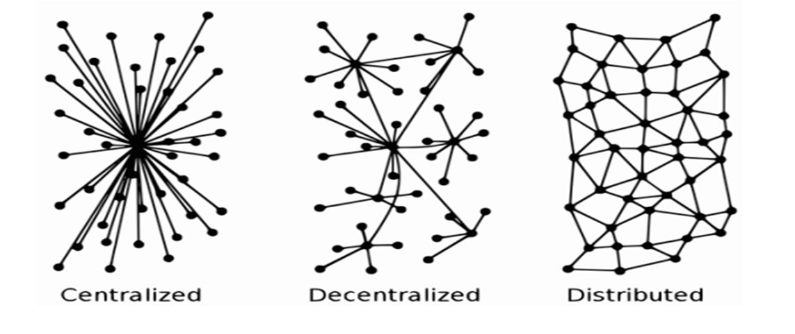
Database Server Architecture

Slide 8
Centralized Database Server Architecture
The database management system is placed on a single server or centralized server.
It is used for very small organization.
Need fewer resources and costs.
It requires regular backup.

Slide 9
Centralized Database Server Architecture
All information sharing and communication is done via that central server.
If that central server gets failed, then all the users get disconnected, and no information sharing is possible.
It is also called the central point of failure.

Slide 10
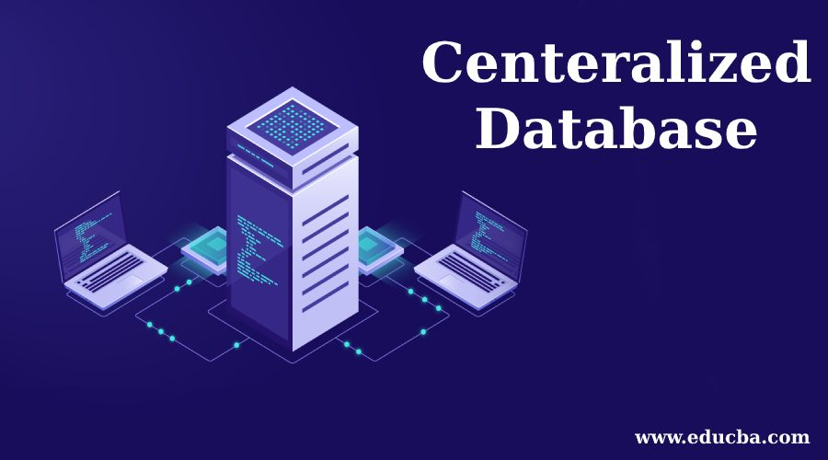

Slide 11
Decentralized Database Server Architecture
In the case of decentralized server architecture, there are multiple servers, and each server has the same copy of the database.
Different users can access data from different servers.

Slide 12
Decentralized Database Server Architecture
This server architecture also helps in load sharing.
Data is controlled by database administrators who have permission to access and update the data.

Slide 13
Distributed Database
When the database is placed in such a manner that multiple copies of the same data are kept on multiple machines in a peer-to-peer model, it is known as distributed database server architecture.
All such machines are known as nodes.

Slide 14


Distributed Database
Ex. Cryptocurrencies like Bitcoin and Ethereum.
Data is managed on thousands of nodes.
Anyone can make their own node to keep a local copy of the data.

Slide 15
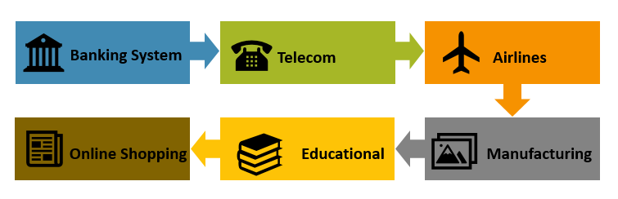
Applications of Database Management System
Telecom
Online shopping
Industry
Railways
Banking System
Sales
Airlines
Education sector

Slide 16
Database Users

Slide 17


Types of Database users
Naïve
Users
Database
Designers
Database
Administrators
Application
Programmers
Sophisticated
Users

Slide 18
Naive users
Naïve Users are unsophisticated users who interact with the system by invoking one of the application programs that have been written previously.
Naive users may also simply read reports generated from the database.

Slide 19
Naive users Contd..
Example:
A clerk in the University who needs to add a new instructor to Department A invokes a program called NEW_HIRE.
This program asks the clerk for the name of the new instructor, her new ID, the name of the Department (i.e., A), and the salary.

Slide 20
Application programmers
These are computer professionals who write application programs.
Application programmers can choose from many tools to develop user interfaces

Slide 21
Sophisticated users
Sophisticated users interact with the system without writing application programs.
These include engineers, scientists, business analysts, and others who are thoroughly familiarized with the DBMS to meet their complex requirements

Slide 22
Database Designer
Database designers are responsible for identifying the data to be stored in the database.
Choose appropriate structures to represent and store this data.
It is the responsibility of the database designer to create a design that meets these requirements.

Slide 23
Database Administrator:
In a database environment, the primary resource is the database itself, and the secondary resource is the DBMS and related software.
Administering these resources is the responsibility of the database administrator (DBA).

Slide 24
Functions of a DBA
Schema definition
Storage structure and access method definition
Schema and physical organization modification
Granting of authorization for data access
Routine maintenance

Slide 25
Can you answer these questions?
Q No1.) Define the roles and responsibilities of DBA.
Q No2.) Differentiate Centralized, Decentralized and distribute database server architecture with diagram?
Q No3. ) Explain the different types of users in DBMS.
Q No 4.) Write 10 applications of DBMS in varied sectors.
Q No.5) Name 10 DBMS’s used now a days.

Slide 26
Summary
Database Server Architecture is categorized in to three different types.
Centralized
Decentralized
Distributed
DBMS is used with almost all domains including Medical, Telecom, Financial, Airlines and Educational Sector.
Database users can be categorized into several classes, and each class of users usually uses a different type of interface to the database.
DBA is responsible for defining schema, authorization and roles of database users.

Slide 27
Thank You

